Slide 2
Measurment and Monitoring section

Slide 3
Objective
Understanding Section Measurement and monitoring
Understand the Measurement and monitoring section Specific Guideline & Coding Tips
Clinical examples for better understanding
Knowledge Check

Slide 4
Definition
Measurement: Determining the level of physiological or physical function at a point in time
Monitoring : : Determining the level of physiological or physical function repetitively over period of time

Slide 5
Coding Tip
The 6th character Specifies the physiological function or physiological device i.e whether it is measured or monitored
Example of physiological or physical function such as
Metabolism
Pulse
Conductivity
Temperature
Volume
The qualifier specifically indicates whether it is done in pulmonary, portal or central
OR a variation of procedure perfomed eg(Ambulatory orStress)

Slide 6
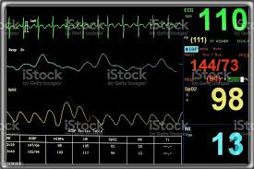
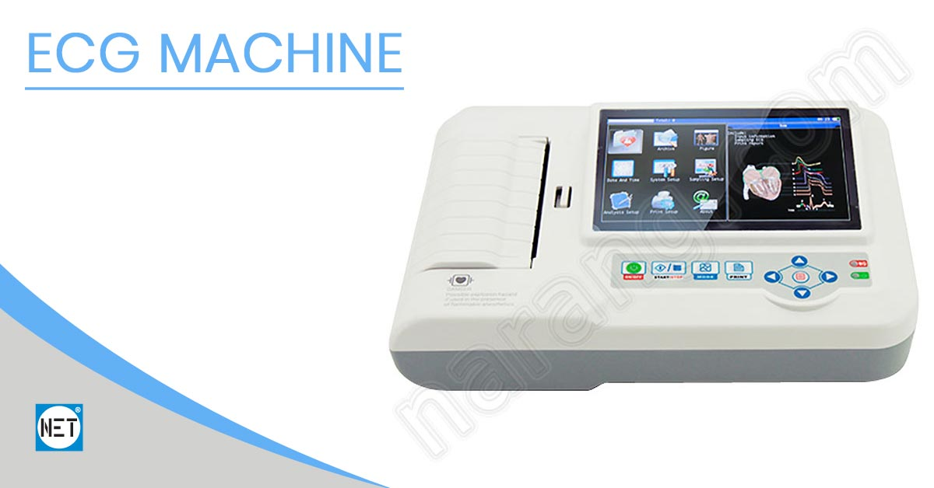
Clinical Examples
EKG
ECG
Cardiac Cath

Slide 7
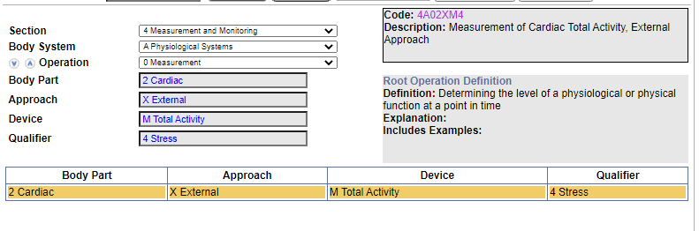
Clinical Example
Cardiac Stress test, Single Measurment ?
ANS: 4A02XM4

Slide 8
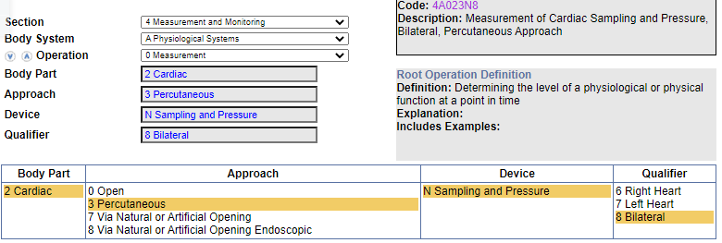
Clinical Example
Bilateral heart cardiac cath with right and left sampling and pressure measurement ?
Ans:4A023N8

Slide 9
Knowledge chaeck
1.Respiratory rate external, Single measurement?
2 Fetal heart rate monitoring transvaginal ?
ANSWER:????????

Slide 10
Answer
4A09XCZ
4A1H7CZ
Let us see the navigation

Slide 11
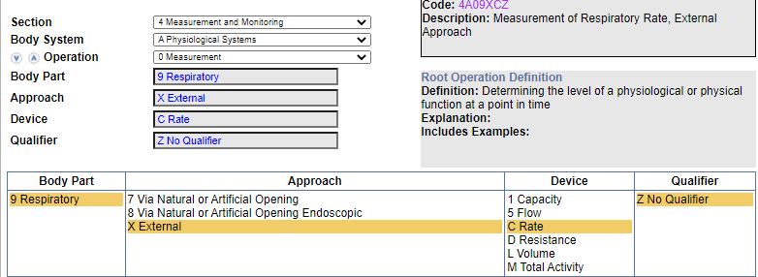
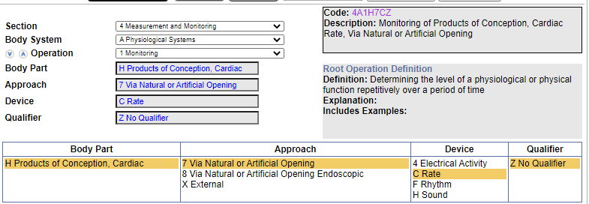

Slide 12
THANK YOU

